Slide 1
Applied Machine Learning Week 3
Grant Schoenebeck
Some slides adapted from material courtesy of Andrew W. Moore @ CMU. See http://www.cs.cmu.edu/~awm/tutorials.html

Slide 2
Outline
Bias-Variance Decomposition of Error
Regularization
Ridge, Lasso
Robust Regression
Logistic Regression
Measuring accuracy
ROC, F1, confusion matrix

Slide 3
Bias-Variance Decomposition of Error

Slide 4
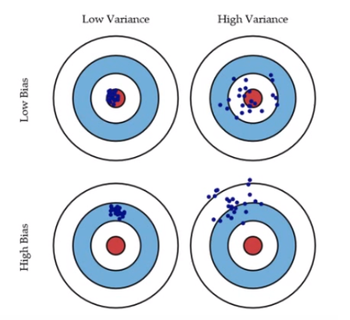
Bias vs variance around a single "target "point

Slide 5
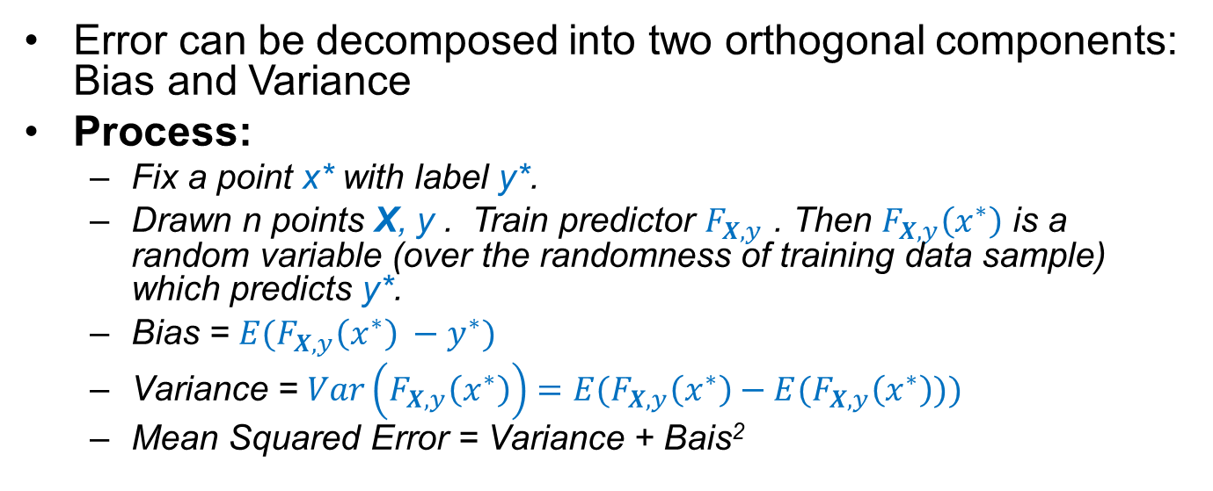
Bias-Variance
Error can be decomposed into two orthogonal components: Bias and Variance
Process:
Fix a point x* with label y*.
Drawn n points X, y . Train predictor $F_{X,y}$ . Then $F_{X,y}\left(x^{∗}\right)$ is a random variable (over the randomness of training data sample) which predicts y*.
Bias = $E(F_{X,y}\left(x^{∗}\right) −y^{∗})$
Variance = $Var\left(F_{X,y}\left(x^{∗}\right)\right)=E(F_{X,y}\left(x^{∗}\right)−E(F_{X,y}\left(x^{∗}\right)))$
Mean Squared Error = Variance + Bais²

Slide 6
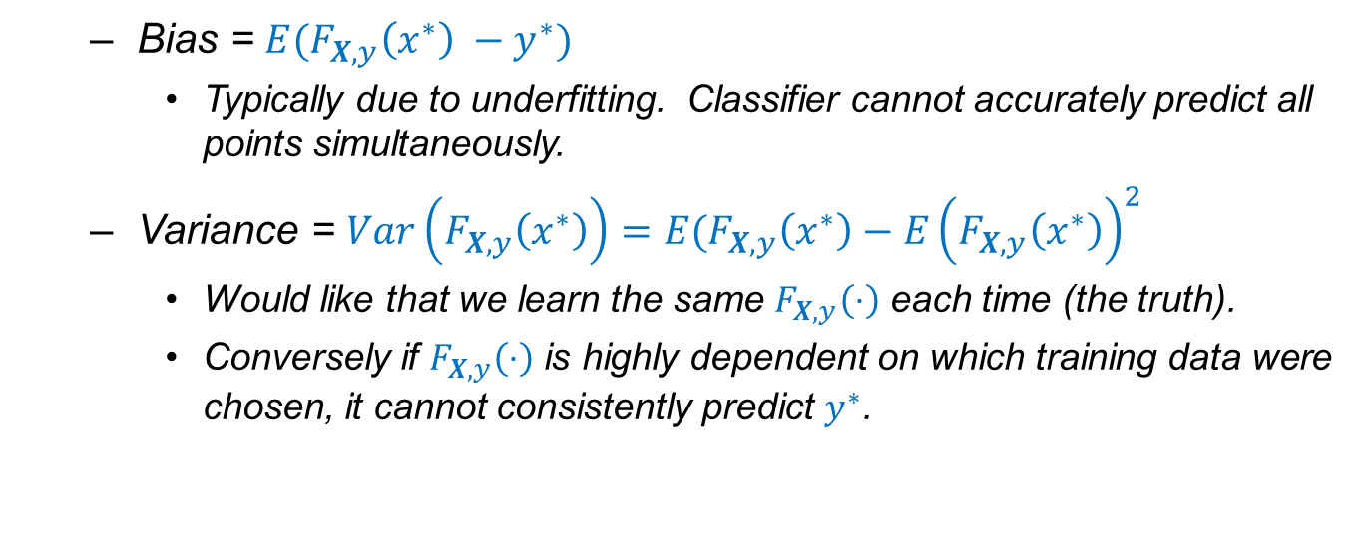
Bias-Variance
Bias = $E(F_{X,y}\left(x^{∗}\right) −y^{∗})$
Typically due to underfitting. Classifier cannot accurately predict all points simultaneously.
Variance = $Var\left(F_{X,y}\left(x^{∗}\right)\right)=E(F_{X,y}\left(x^{∗}\right)−E{\left(F_{X,y}\left(x^{∗}\right)\right)}^{2}$
Would like that we learn the same $F_{X,y}\left(⋅\right)$ each time (the truth).
Conversely if $F_{X,y}\left(⋅\right)$ is highly dependent on which training data were chosen, it cannot consistently predict $y^{∗}$.

Slide 7
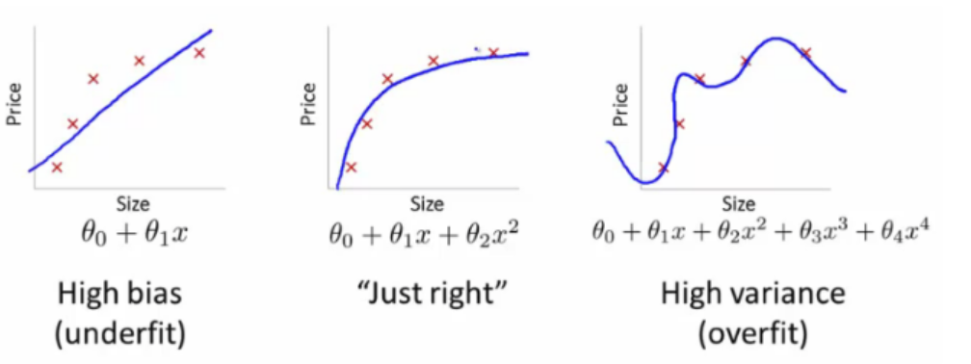
Bias-variance tradeoffs
How to restrict the complexity of the model family used to fit the data?
We'll learn about something called regularization…

Slide 8
Regularization

Slide 9
Problems with ordinary least-squares regression
Large coefficients w_{i} often yield large variance
huge weights can cancel each other out.
We prefer models low weights.
We prefer models with few explanatory variables.

Slide 10
Colinear data
If two columns are nearly collinear, then small error can induce large coefficients.
E.g x₁ = (100, 0) y₁ = 5; x₂ =(100, .1) y₂ = -5 predict x₃= (100, 1) can take: x₃ =10 x₂ – 10x₁ by Linearity: y₃ = -100
X₀ | X₁ | X₂ | Y
1 | 2 | 4 | 16
1 | 3 | 4 | 17
1 | 5 | 5 | 20

Slide 11
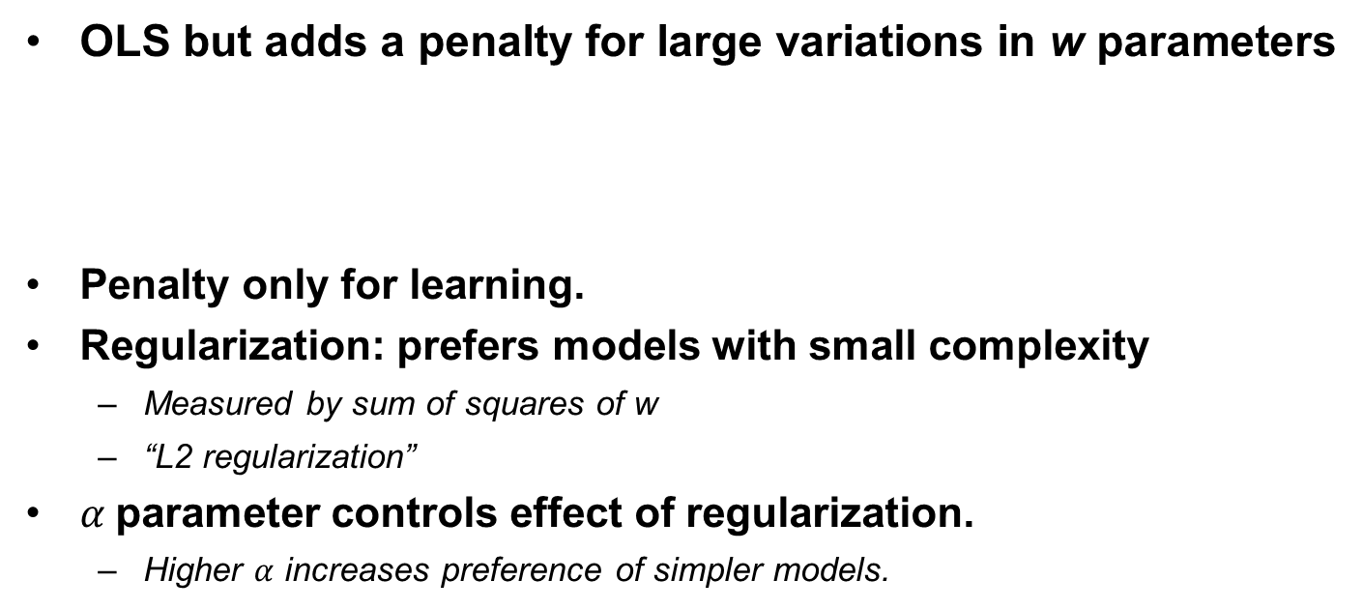
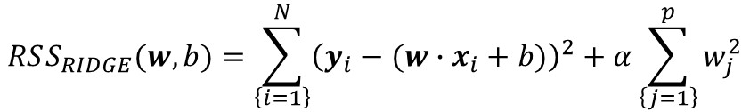
Ridge Regression
OLS but adds a penalty for large variations in w parameters
Penalty only for learning.
Regularization: prefers models with small complexity
Measured by sum of squares of w
“L2 regularization”
$α$parameter controls effect of regularization.
Higher $α$ increases preference of simpler models.
$$RSS_{RIDGE}(w,b)=\sum_{\left\{i=1\right\}}^{N}{{\left(y_{i}−{(w∙x}_{i} + b)\right)}^{2}+α\sum_{\left\{j=1\right\}}^{p}{w_{j}^{2}}}$$

Slide 12
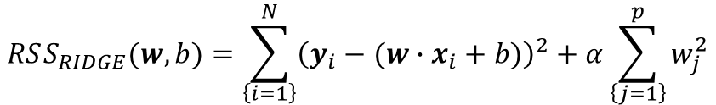
Ridge Regression
WARNING: You must normalize inputs when you use Ridge Regression, why?
$$RSS_{RIDGE}(w,b)=\sum_{\left\{i=1\right\}}^{N}{{\left(y_{i}−{(w∙x}_{i} + b)\right)}^{2}+α\sum_{\left\{j=1\right\}}^{p}{w_{j}^{2}}}$$

Slide 13
Think, Pair, Share
Ridge Regression Trades off:
A) decreases Variance but may increase Bias
B) decreases Bias for may increase Variance

Slide 14
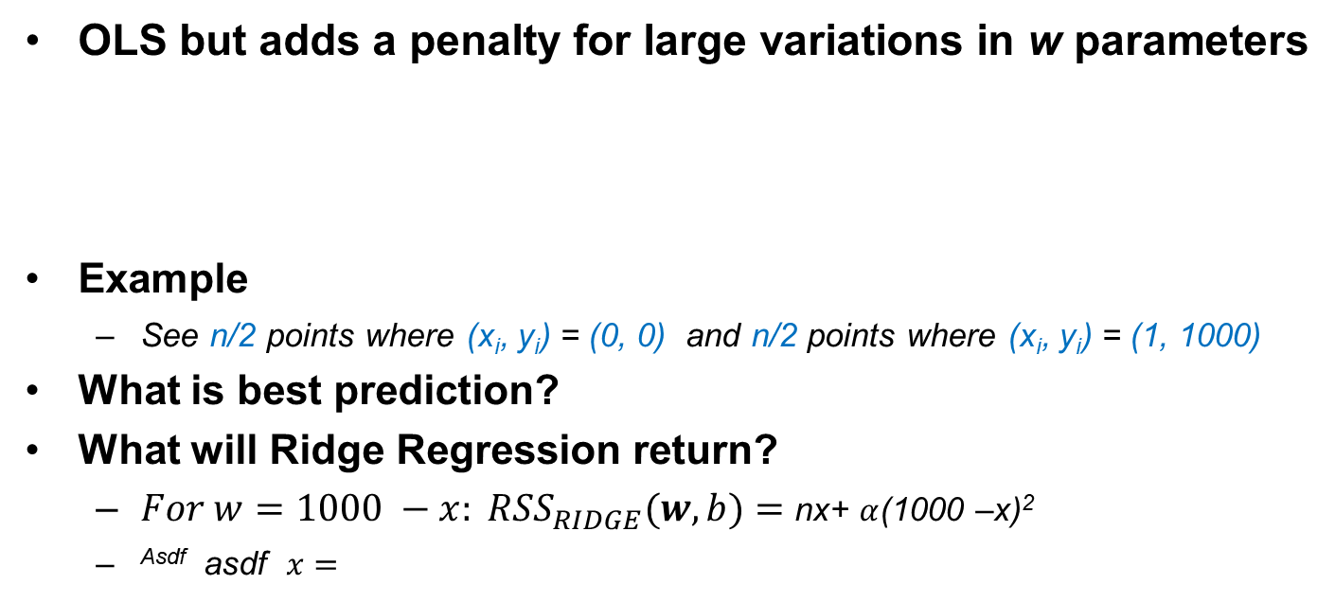
Ridge Regression
OLS but adds a penalty for large variations in w parameters
Example
See n/2 points where (x_{i}, y_{i}) = (0, 0) and n/2 points where (x_{i}, y_{i}) = (1, 1000)
What is best prediction?
What will Ridge Regression return?
$For w=1000 −x: RSS_{RIDGE}(w,b)=$ nx+ $α$(1000 –x)²
^{Asdf} asdf $x=$
$$RSS_{RIDGE}(w,b)=\sum_{\left\{i=1\right\}}^{N}{{\left(y_{i}−{(w∙x}_{i} + b)\right)}^{2}+α\sum_{\left\{j=1\right\}}^{p}{w_{j}^{2}}}$$

Slide 15
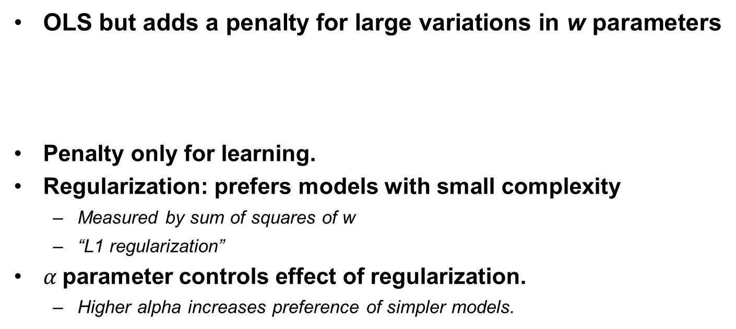
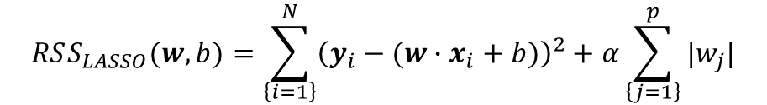
Lasso regression
OLS but adds a penalty for large variations in w parameters
Penalty only for learning.
Regularization: prefers models with small complexity
Measured by sum of squares of w
“L1 regularization”
$α$parameter controls effect of regularization.
Higher alpha increases preference of simpler models.
$$RSS_{LASSO}(w,b)=\sum_{\left\{i=1\right\}}^{N}{{\left(y_{i}−{(w∙x}_{i} + b)\right)}^{2}+α\sum_{\left\{j=1\right\}}^{p}{|w_{j}|}}$$

Slide 16
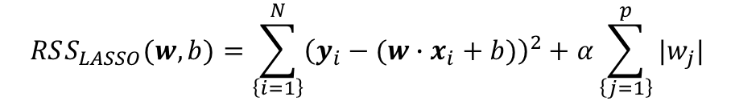
Lasso Regression
WARNING: You must normalize inputs when you use Lasso Regression, why?
$$RSS_{LASSO}(w,b)=\sum_{\left\{i=1\right\}}^{N}{{\left(y_{i}−{(w∙x}_{i} + b)\right)}^{2}+α\sum_{\left\{j=1\right\}}^{p}{|w_{j}|}}$$

Slide 17
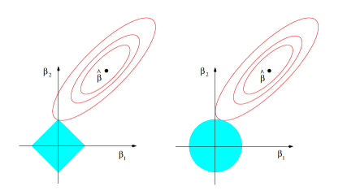
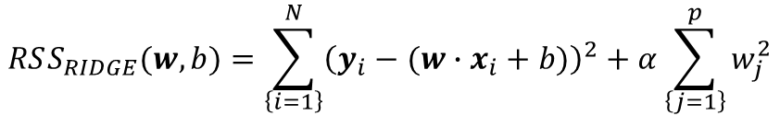
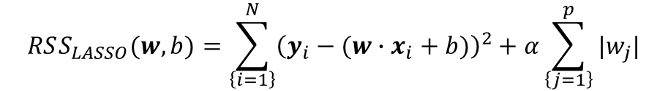
Ridge vs Lasso
$$RSS_{RIDGE}(w,b)=\sum_{\left\{i=1\right\}}^{N}{{\left(y_{i}−{(w∙x}_{i} + b)\right)}^{2}+α\sum_{\left\{j=1\right\}}^{p}{w_{j}^{2}}}$$
$$RSS_{LASSO}(w,b)=\sum_{\left\{i=1\right\}}^{N}{{\left(y_{i}−{(w∙x}_{i} + b)\right)}^{2}+α\sum_{\left\{j=1\right\}}^{p}{|w_{j}|}}$$
Notes:
Ridge: Increasing w from 3 to 4 requires more improvement than increasing from 1 to 2.
Lasso: imposes same penalty to get from 0 to 1 as from 99 to 100.

Slide 18
Ridge vs Lasso
Use Ridge:
Many small/medium sized effects
Use Lasso:
Only a few variables with medium/large effect
Think “Lasso” the important variables.

Slide 19
Ridge and Lasso
Part of a class of methods called “Shrikage” methods
Can be computed efficiently using convex methods.

Slide 20
Lasso Regression on the Communities and Crime Dataset
For alpha = 2.0, 20 out of 88 features have non-zero weight.
Top features (sorted by abs. magnitude):
PctKidsBornNeverMar, 1488.365 # percentage of kids born to people who never married
PctKids2Par, -1188.740 # percentage of kids in family housing with two parents
HousVacant, 459.538 # number of vacant households
PctPersDenseHous, 339.045 # percent of persons in dense housing (more than 1 person/room)
NumInShelters, 264.932 # number of people in homeless shelters

Slide 21
Adding non–polynomial Features
Examples:
Population of a city versus number of billionaires?
Revenue of a company versus number of vice presidents?
Number of employees versus layers of management?
Might try to add sublinear features:
Also, can add transformations of data:
QuantileTransformer (transform to uniform)
Can also output normal

Slide 22
Non-linear Regression
How to learn w?
Notes:
Can use more general methods to estimate MLE of w, in this class, we will use generic non-linear estimators.

Slide 23
Robust Regression
y
x

Slide 24
Robust Regression
This is the best fit that Quadratic Regression can manage
y
x

Slide 25
Robust Regression
…but this is what we’d probably prefer
y
x

Slide 26
Robust Regression
After the initial fit, score each datapoint according to how well it’s fitted…
y
You are a very good datapoint.
x

Slide 27
Robust Regression
After the initial fit, score each datapoint according to how well it’s fitted…
y
You are a very good datapoint.
You are not too shabby.
x

Slide 28
Robust Regression
After the initial fit, score each datapoint according to how well it’s fitted…
But you are pathetic.
y
You are a very good datapoint.
You are not too shabby.
x

Slide 29
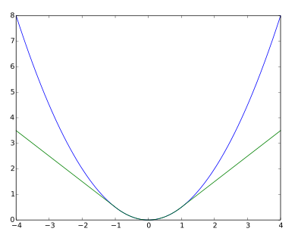
Robust Regression
Solutions:
Use HuberRegressor
Linear loss for outliers.
Implimented in SciKit Learn
Use RANSAC (RANdom SAmple Consensus)
Implemented in SciKit Learn
Fits to subset of points, then only uses “good points”
MLE for a different model (LOESS robust regression)
Uses EM algorithms

Slide 30
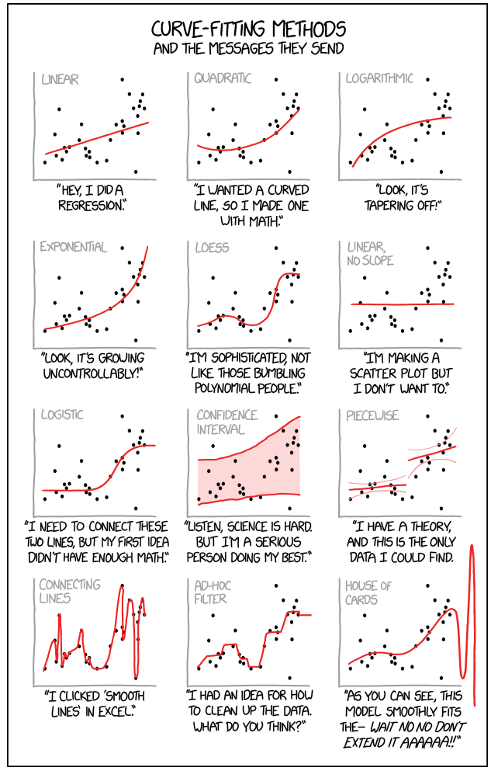
https://m.xkcd.com/2048/
alt-text:
Cauchy-Lorentz: "Something alarmingly mathematical is happening, and you should probably pause to Google my name and check what field I originally worked in."

Slide 31
Logistic regression

Slide 32
Is Logistic Regression Really Regression?
Logistic Regression is a “soft” classifier.
Like the weather, it provides a forecast.
Since this is a real number, called a regression.
You can imagine cases where this is more or less appropriate:
More: Not enough Given past 4 rock/paper/scissors actions, predict next action.
Given a picture of a rock, is it quartz?

Slide 33
Recall: Linear Regression
Input features
1
b
Output
x₁
w₁
w₂
y
x₂
w₃
x₃
$$\hat{y}=\hat{b}+{\hat{w}}_{1}⋅x_{1}+…{\hat{w}}_{n}{⋅x}_{n}$$

Slide 34
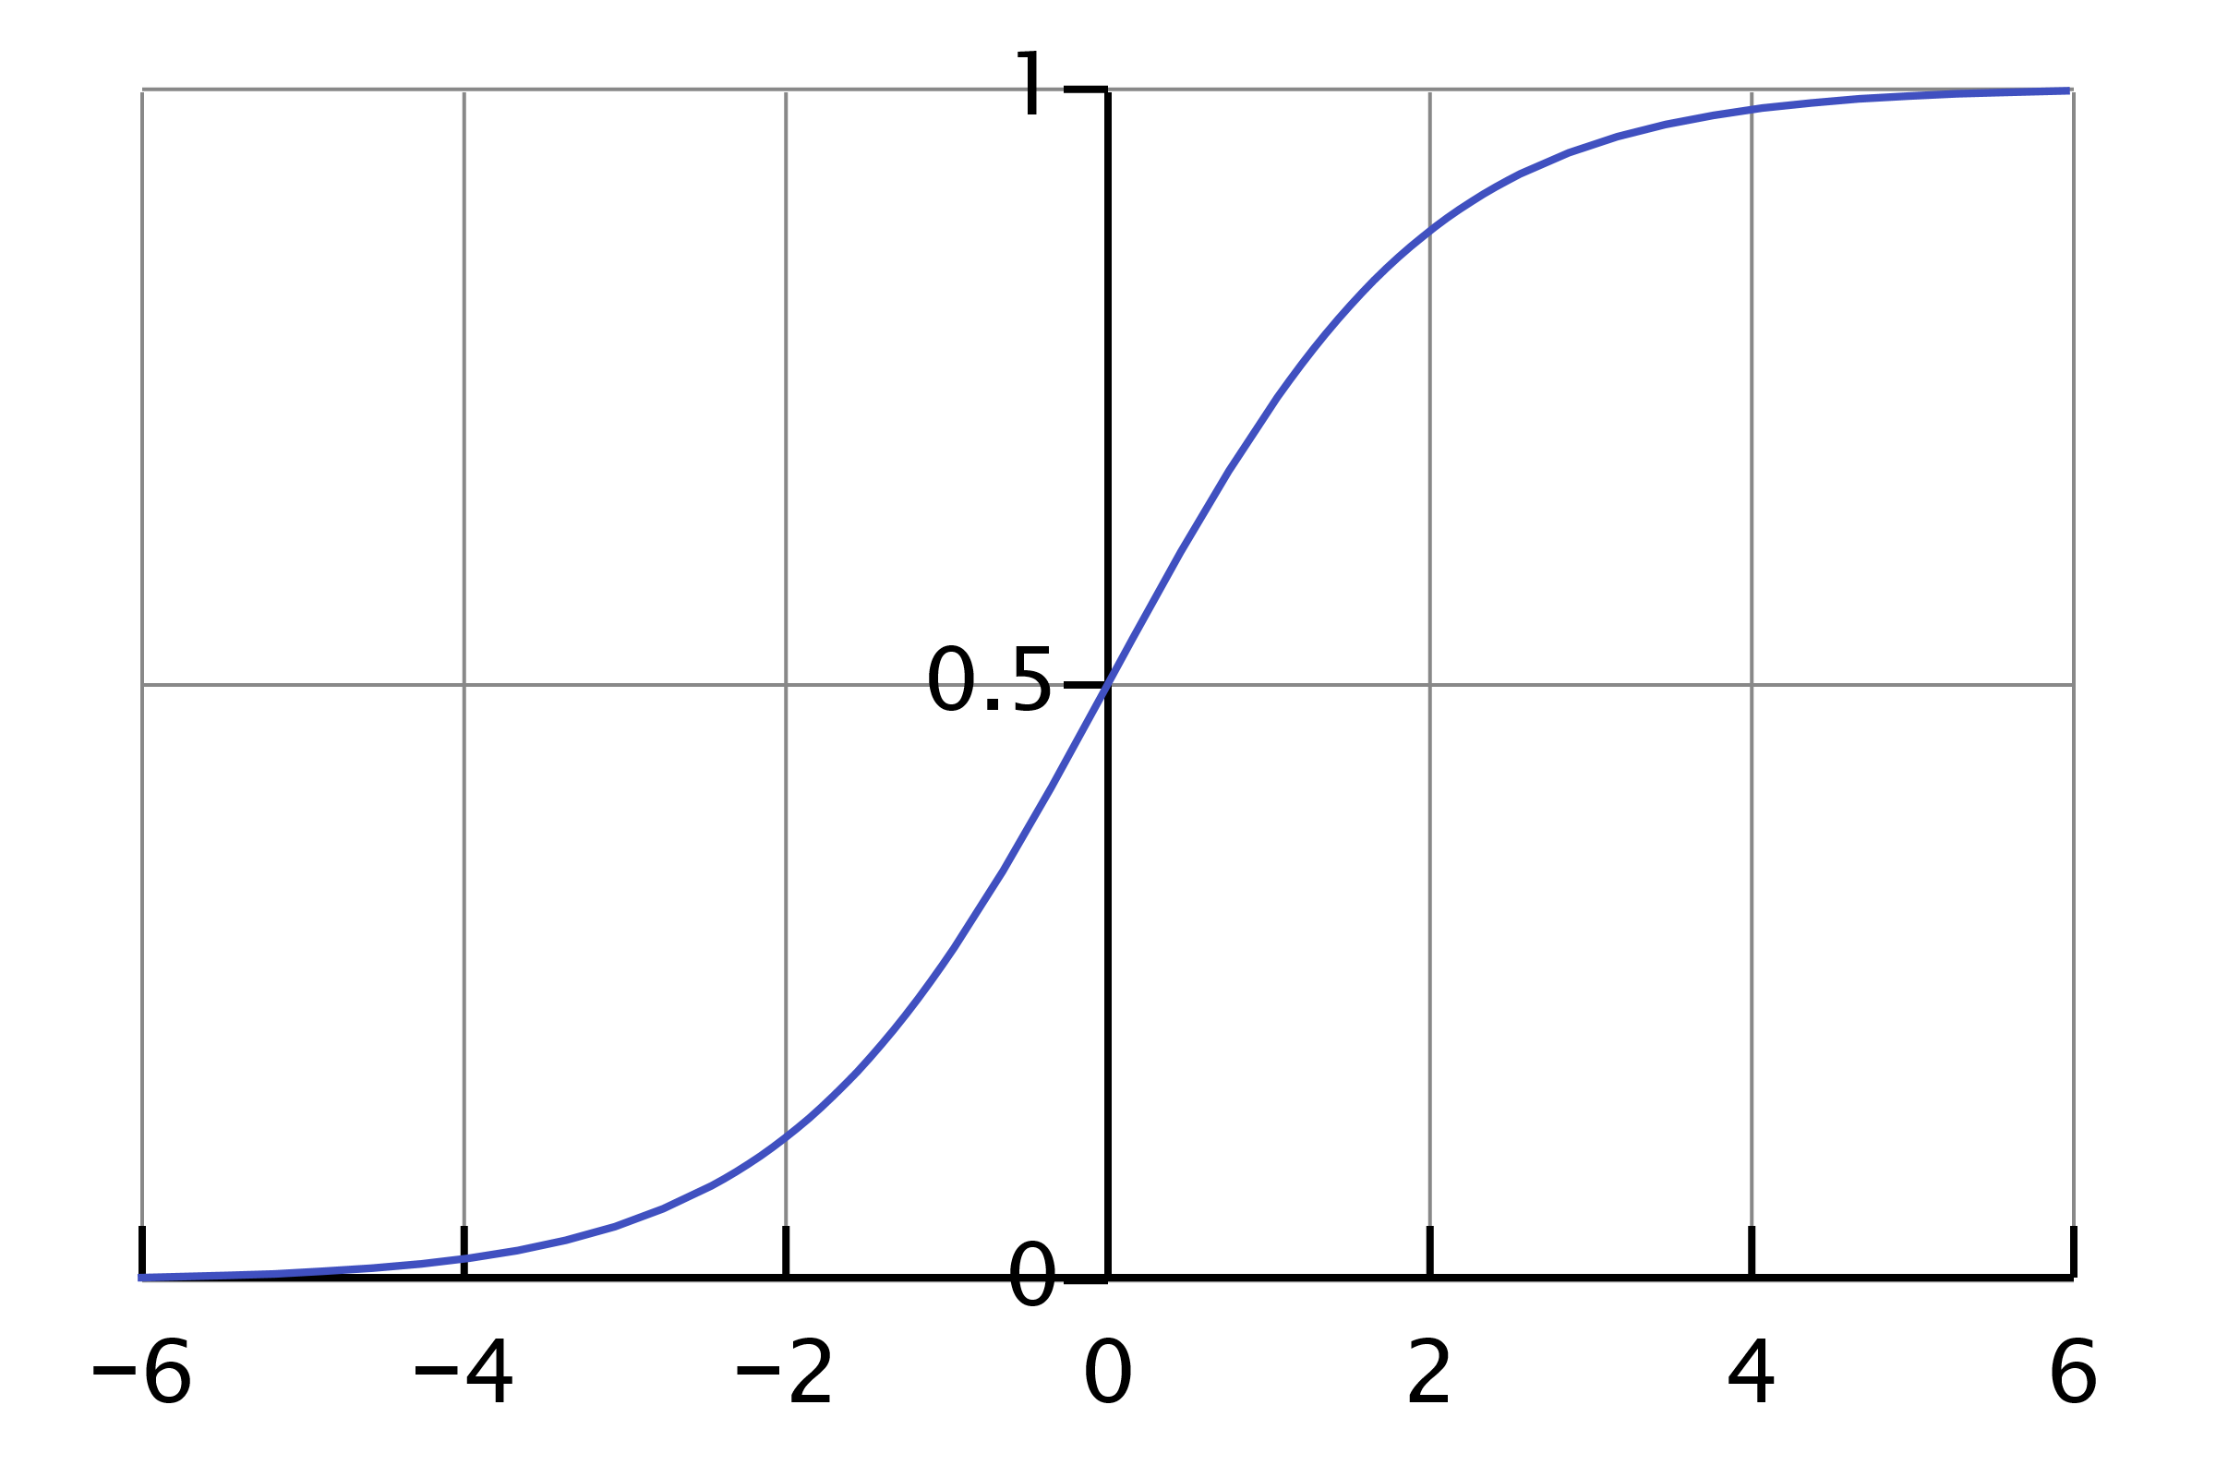
Linear models for classification: Logistic Regression
Input features
1
b
$$f(⋅)$$
$$y∈(0, 1)$$
x₁
w₁
w₂
y
x₂
w₃
x₃
$$\hat{y}= logistic(\hat{b}+{\hat{w}}_{1}⋅x_{1}+…{\hat{w}}_{n}{⋅x}_{n}\text{)}$$
$$= \frac{1}{1+\exp{[−}(\hat{b}+{\hat{w}}_{1}⋅x_{1}+…{\hat{w}}_{n}{⋅x}_{n})]}$$

Slide 35

Linear models for classification: Logistic Regression
Input features
1
The logistic function transforms real-valued input to an output number y between 0 and 1, interpreted as the probability the input object belongs to the positive class, given its input features $\left(x_{0},x_{1},…, x_{n}\right)$
b
$$f(⋅)$$
$$(0, 1)$$
x₁
w₁
w₂
y
x₂
w₃
x₃
$$\hat{y}= logistic(\hat{b}+{\hat{w}}_{1}⋅x_{1}+…{\hat{w}}_{n}{⋅x}_{n}\text{)}$$
$$= \frac{1}{1+\exp{[−}(\hat{b}+{\hat{w}}_{1}⋅x_{1}+…{\hat{w}}_{n}{⋅x}_{n})]}$$

Slide 36
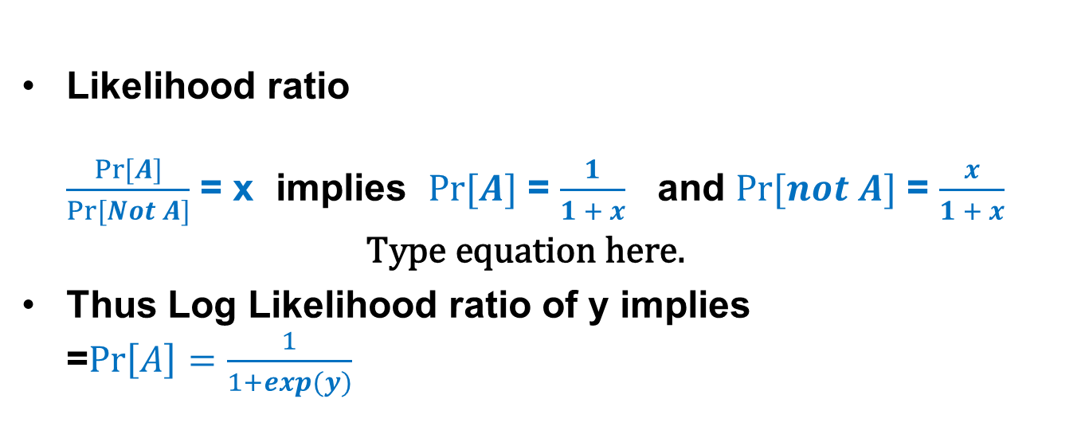
Why?
Likelihood ratio $\frac{\operatorname{Pr}{[A]}}{\operatorname{Pr}{[Not A]}}$ = x implies $\operatorname{Pr}{[A]}$ = $\frac{1}{1 + x}$ and $\operatorname{Pr}{[not A]}$ = $\frac{x}{1 + x}$
Thus Log Likelihood ratio of y implies =$\operatorname{Pr}\left[A\right]=\frac{1}{1+exp(y)}$

Slide 37
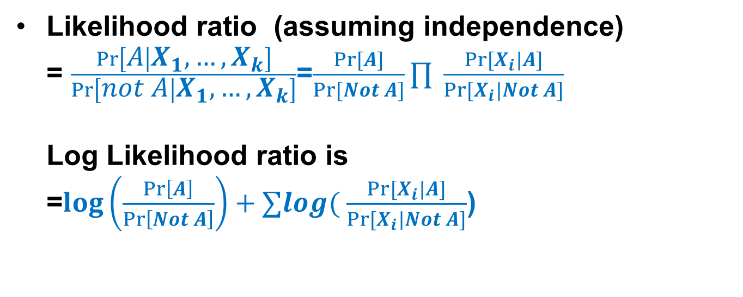
Why?
Likelihood ratio (assuming independence) = $\frac{\operatorname{Pr}\left[A | X_{1}, …, X_{k}\right]}{\operatorname{Pr}\left[not A | X_{1}, …, X_{k}\right]}$=$\frac{\operatorname{Pr}{[A]}}{\operatorname{Pr}{[Not A]}}∏ \frac{\operatorname{Pr}{[X_{i}|A]}}{\operatorname{Pr}{[X_{i}|Not A]}}$ Log Likelihood ratio is =$log\left(\frac{\operatorname{Pr}\left[A\right]}{\operatorname{Pr}\left[Not A\right]}\right)+∑log( \frac{\operatorname{Pr}{[X_{i}|A]}}{\operatorname{Pr}{[X_{i}|Not A]}}$)

Slide 38
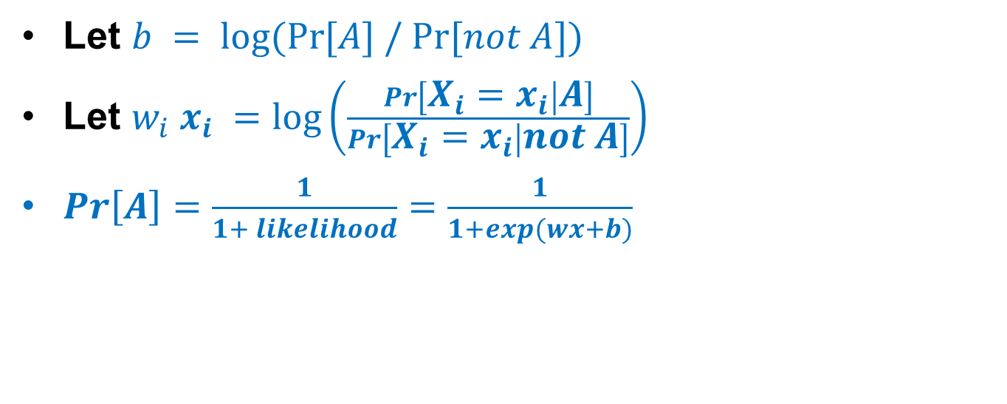
Why?
Let $b = log⁡(Pr⁡[A] / Pr⁡[not A])$
Let $w_{i} x_{i} =\log\left(\frac{\operatorname{Pr}\left[X_{i}=x_{i} | A\right]}{Pr\left[X_{i}=x_{i} | not A\right]}\right)$
$Pr\left[A\right]=\frac{1}{1+ likelihood}=\frac{1}{1+exp(wx+b)}$

Slide 39
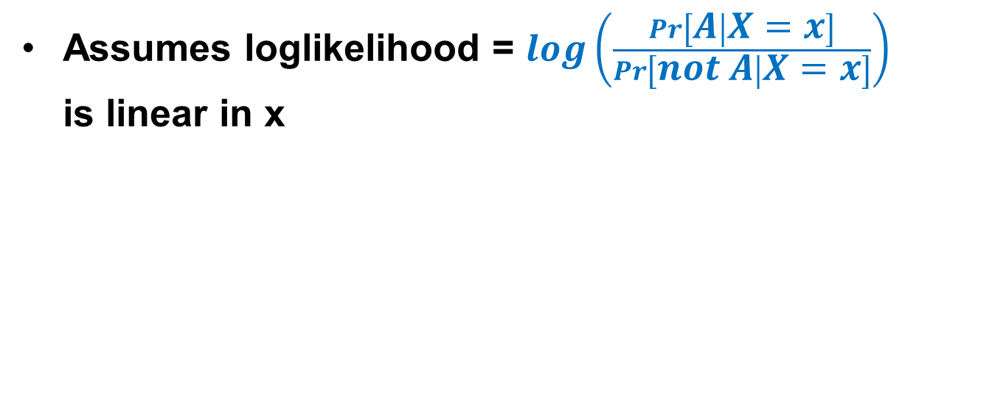
Take Away
Assumes loglikelihood = $log\left(\frac{Pr\left[A | X=x\right]}{Pr\left[not A | X=x\right]}\right)$ is linear in x

Slide 40
Linear models for classification: Logistic Regression
1.00
Probability of passing exam
0.50
0.00
0.00 1 2 3 4 5 6
Hours studying

Slide 41
Linear models for classification: Logistic Regression
1.00
Probability of passing exam
0.50
0.00
0.00 1 2 3 4 5 6
Hours studying

Slide 42
Logistic Regression for binary classification
Feature 2
Feature 1

Slide 43
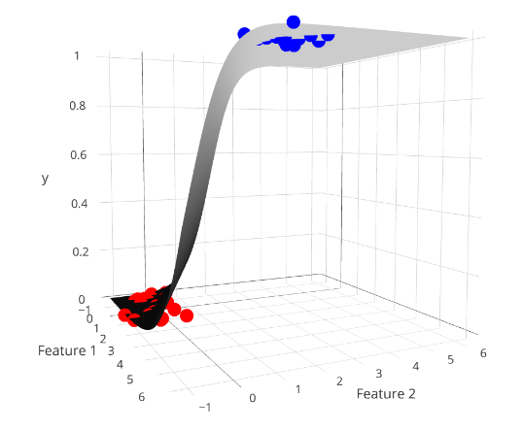
Logistic Regression for binary classification
y =1
y = 0.5
y = 0
Feature 2
Feature 1

Slide 44
Logistic Regression for binary classification
$$\hat{y}<0.5$$
$$\hat{y}≥0.5$$
Feature 2
Feature 1

Slide 45
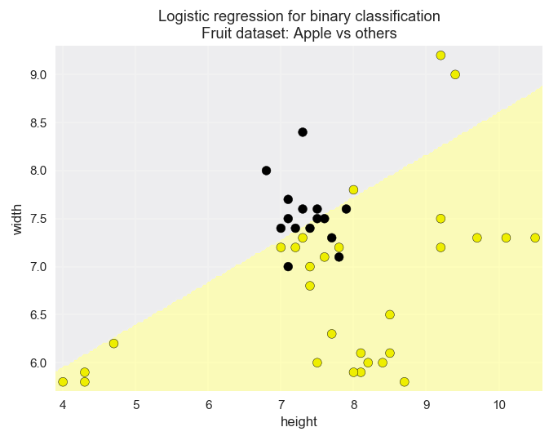
Simple logistic regression problem: two-class, two-feature version of the fruit dataset
apple
not an apple

Slide 46
What is output?
.predict(x)
category
.predict_proba(x)
Probability estimates
Soft classifier
.predict_log_proba(x)
Log probability estimates

Slide 47
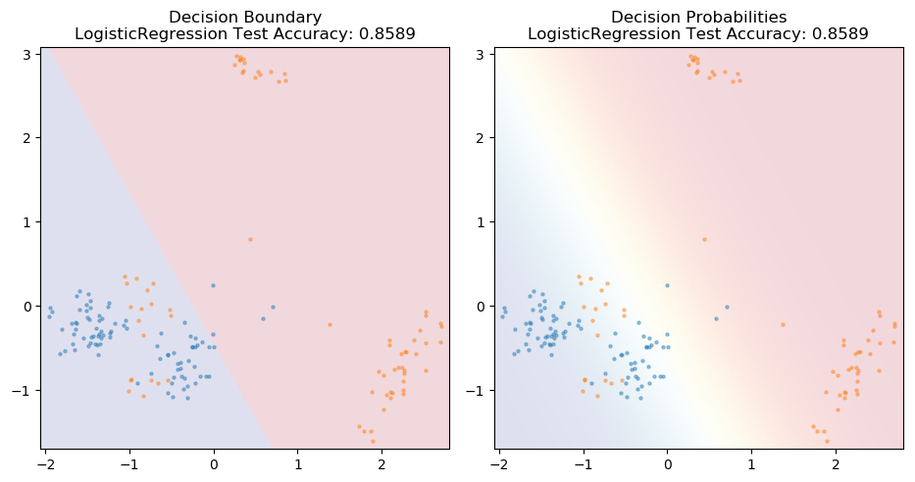
Hard vs Soft Classification
0.98
0.50
0.50
1
0.75
0
0.35
0.50
0.05

Slide 48
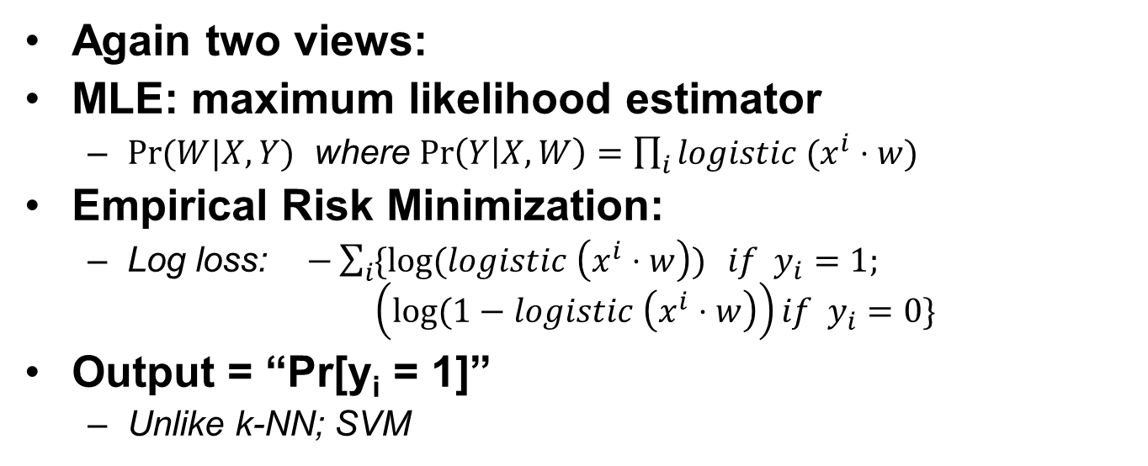
What is being optimized?
Again two views:
MLE: maximum likelihood estimator
$Pr⁡(W|X, Y)$ where $\operatorname{Pr}\left(Y | X, W\right)=\prod_{i}{logistic (x^{i}⋅w)}$
Empirical Risk Minimization:
Log loss: $−\sum_{i}{\{log⁡(logistic \left(x^{i}⋅w\right))} if y_{i}=1;$ $\left(log⁡(1−logistic \left(x^{i}⋅w\right)\right)if y_{i}=0\}$
Output = “Pr[y_{i} = 1]”
Unlike k-NN; SVM

Slide 49
Logistic Regression
Intuition
Parameters
Regularization (on by default), L₁ or L₂
Regularization Parameter c (smaller is more regularized)
class_weight
Computation:
Convex space
Evaluation
Coming up!

Slide 50
Model Evaluation for Logistic Regression
Beyond Accuracy

Slide 51
Evaluation
Different applications have very different goals
Accuracy is widely used, but many others are possible, e.g.:
User satisfaction (Web search)
Amount of revenue (e-commerce)
Increase in patient survival rates (medical)
Notes:
#Eval_Objectives

Slide 52
Evaluation
It's very important to choose evaluation methods that match the goal of your application.
Compute your selected evaluation metric for multiple different models.
Then select the model with 'best' value of evaluation metric.
Notes:
#Eval_Objectives

Slide 53
Accuracy with imbalanced classes
Suppose you have two classes:
Relevant (R): the positive class
Not_Relevant (N): the negative class
Out of 1000 randomly selected items, on average
One item is relevant and has an R label
The rest of the items (999 of them) are not relevant and labelled N.
Recall that:
Accuracy = #correct predictions
#total instances
Notes:
Accuracy_imbalanced

Slide 54
Accuracy with imbalanced classes
You build a classifier to predict relevant items, and see that its accuracy on a test set is 99.9%.
Wow! Amazingly good, right?
For comparison, suppose we had a "dummy" classifier that didn't look at the features at all, and always just blindly predicted the most frequent class (i.e. the negative N class).
Notes:
Accuracy_imbalanced_2

Slide 55
Accuracy with imbalanced classes
Assuming a test set of 1000 instances, what would this dummy classifier's accuracy be?
Answer: Accuracy_{DUMMY} = 999 / 1000 = 99.9%
Notes:
Accuracy_imbalanced_2

Slide 56
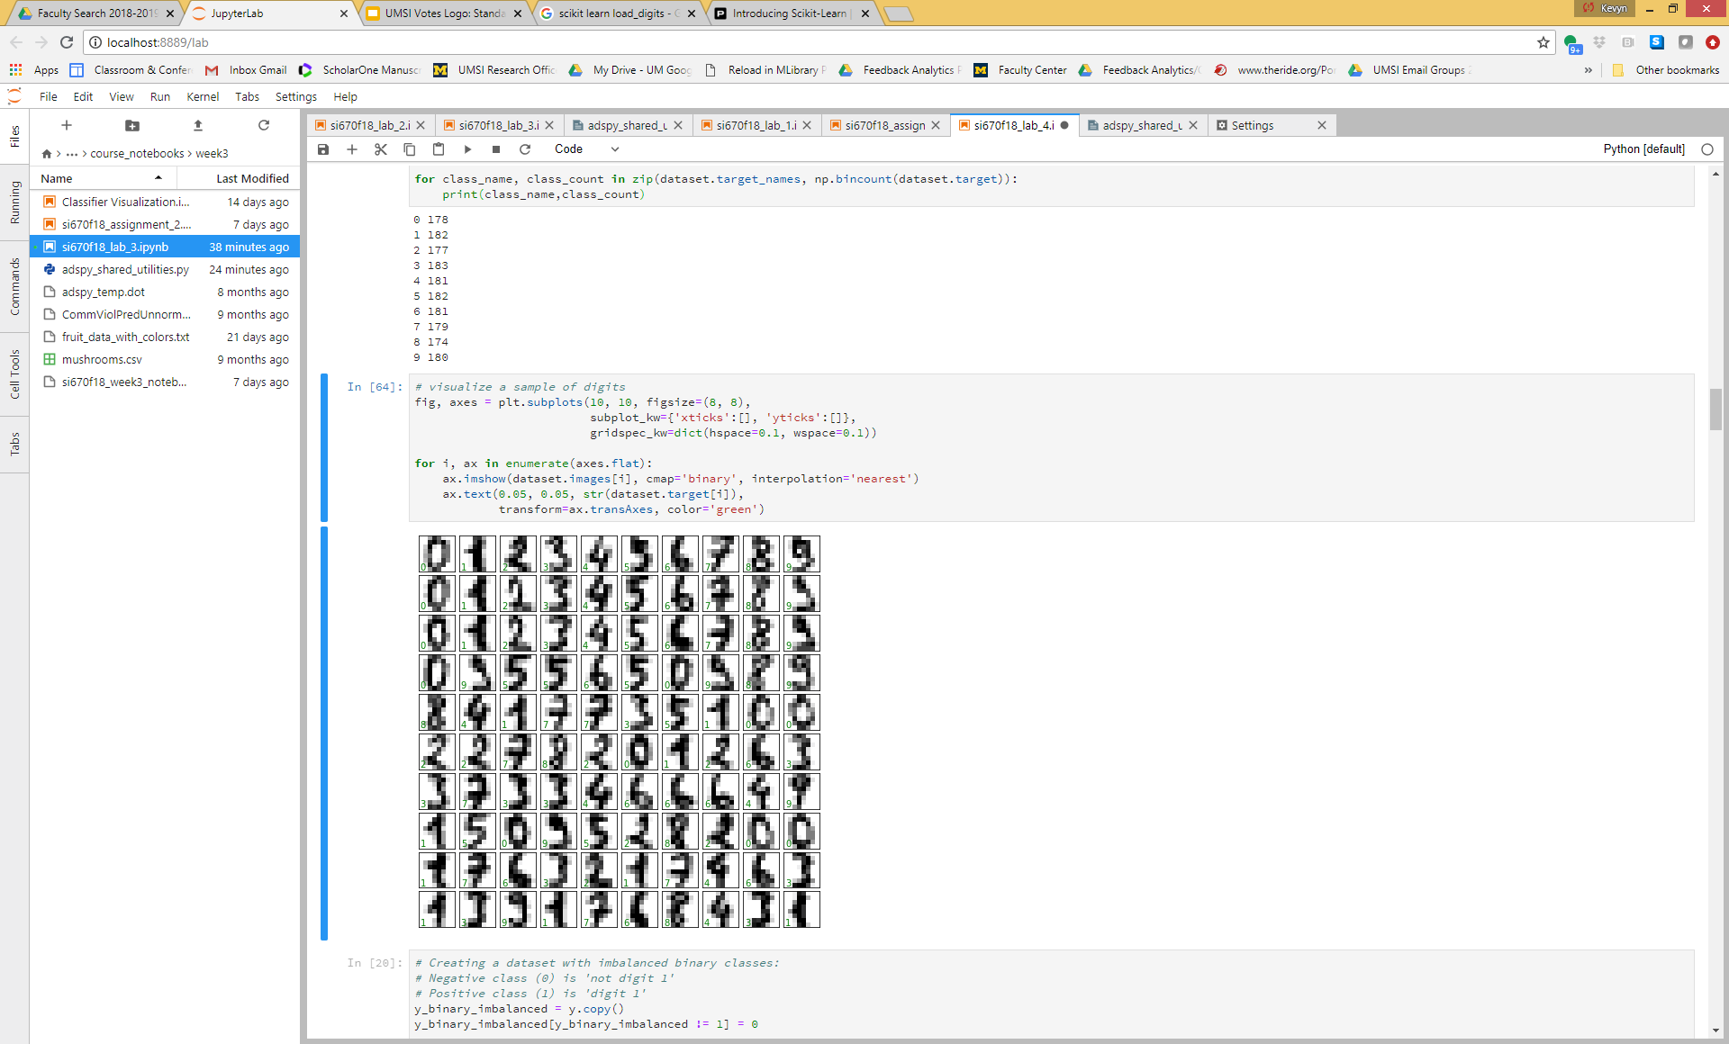
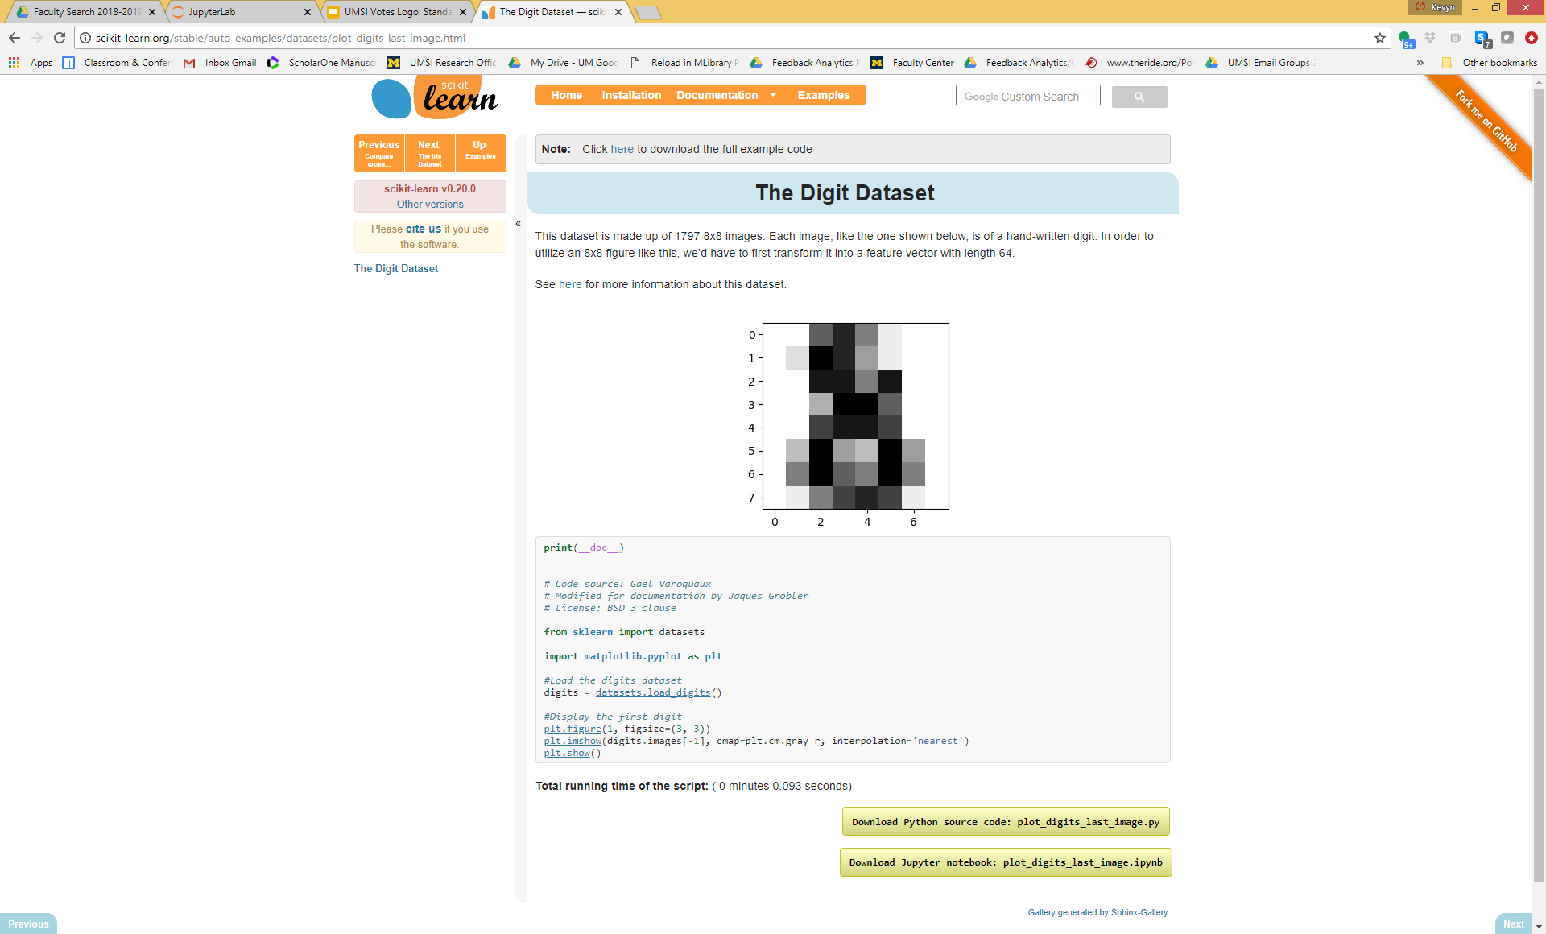
New dataset! load_digits
1,797 examples
8x8 handwritten digits

Slide 57
Let's try learning a classifier on this digits dataset
Predict 1 or not 1
Actual sophisticated Logistic Regression classifier: 90.89%

Slide 58
Create a binary classification problem: is digit 1 vs NOT digit 1
A "dummy" classifier that always guessed "is 1" would be correct 182/1797 = 10.13% of the time
What is the most frequent of the two classes?

Slide 59
Create a binary classification problem: is digit 1 vs NOT digit 1
A "dummy" classifier that always guessed "is 1" would be correct 182/1797 = 10.13% of the time
What is the most frequent of the two classes? NOT 1.
A classifier that always guessed "NOT 1" would be correct 1 – 0.1013 = 89.87% of the time

Slide 60
Let's try learning a classifier on this digits dataset
Actual sophisticated Logistic Regression classifier: 90.89%
Dummy classifier: 89.87%
The "dummy" isn't looking so dumb right about now (though we never would put it into production…)

Slide 61
Dummy classifiers completely ignore the input data!
Dummy classifiers serve as a sanity check on your classifier's performance.
They provide a null metric (e.g. null accuracy) baseline.
Dummy classifiers should not be used for real problems.
Notes:
Dummy_classifiers

Slide 62
Dummy classifiers completely ignore the input data!
Some commonly-used settings for the strategy parameter for DummyClassifier in scikit-learn:
most_frequent : predicts the most frequent label in the training set.
stratified : random predictions based on training set class distribution.
uniform : generates predictions uniformly at random.
constant : always predicts a constant label provided by the user.
Notes:
Dummy_classifiers

Slide 63
What if my classifier accuracy is close to the null accuracy baseline?
This could be a sign of:
Ineffective, erroneous or missing features
Poor choice of kernel or hyperparameter
Large class imbalance
Notes:
Close_to_random

Slide 64
Dummy regressors
strategy parameter options:
mean : predicts the mean of the training targets.
median : predicts the median of the training targets.
quantile : predicts a user-provided quantile of the training targets.
constant : predicts a constant user-provided value.
Notes:
#dummy_regressors

Slide 65
Binary prediction outcomes
TN | FP
FN | TP
True
negative
Label 1 = positive class
(class of interest)
Label 0 = negative class (everything else)
TP = true positive
FP = false positive (Type I error)
TN = true negative
FN = false negative (Type II error)
True
positive
Predicted negative
Predicted positive
Notes:
Types_of_Errors

Slide 66
Confusion matrix for binary prediction task
TN = 356 | FP = 51
FN = 38 | TP = 5
Every test instance is in exactly one box (integer counts).
Breaks down classifier results by error type.
Thus, provides more information than simple accuracy.
Helps you choose an evaluation metric that matches project goals.
Not a single number like accuracy.. but there are many possible metrics that can be derived from the confusion matrix.
True negative
N = 450
True
positive
Predicted
negative
Predicted
positive
Notes:
Confusion_matrix

Slide 67
Confusion Matrix for Binary Prediction Task
True negative
TN = 400 | FP = 7
FN = 17 | TP = 26
Always look at the confusion matrix for your classifier.
True
positive
N = 450
Predicted
negative
Predicted
positive
Notes:
Confusion_matrix

Slide 68
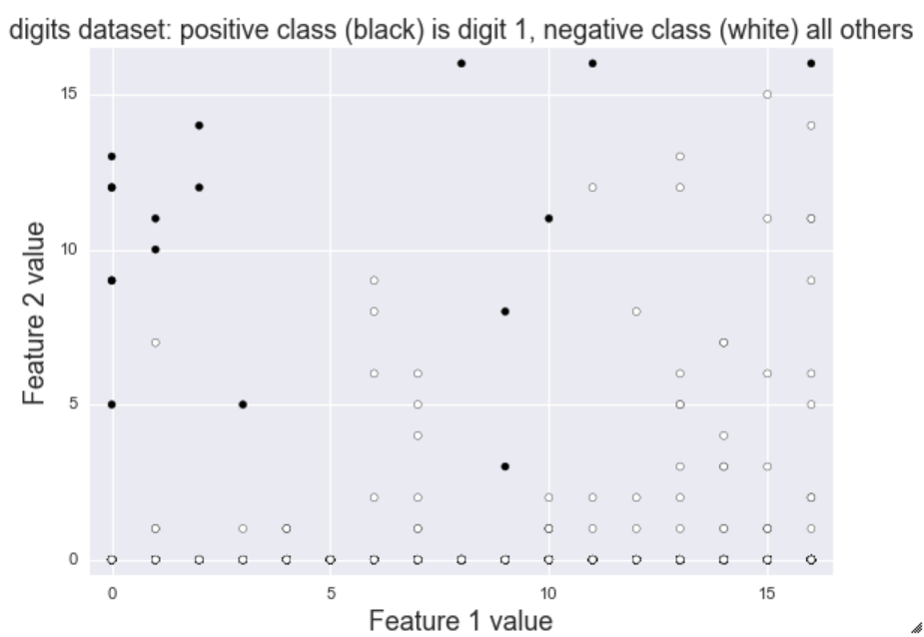
Visualization of Different Error Types
True positive
TN = 429 | FP = 6
FN = 2 | TP = 13
Predict
Positive
Predict
Negative
False positive
True negative
False negative
Notes:
Graphical_error_types

Slide 69
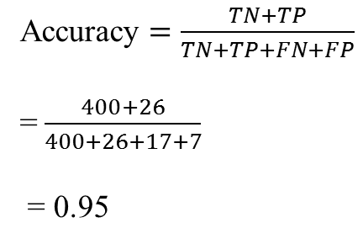
Accuracy: for what fraction of all instances is the classifier's prediction correct (for either positive or negative class)?
TN = 400 | FP = 7
FN = 17 | TP = 26
True negative
Accuracy $=\frac{TN+TP}{TN+TP+FN+FP}$
= $\frac{400+26}{400+26+17+7}$
= 0.95
True
positive
N = 450
Predicted
negative
Predicted
positive
Notes:
Confusion_matrix_accuracy

Slide 70
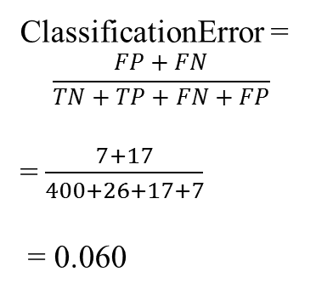
Classification error (1 – Accuracy): for what fraction of all instances is the classifier's prediction incorrect?
TN = 400 | FP = 7
FN = 17 | TP = 26
True negative
ClassificationError =
$$\frac{FP+FN}{TN+TP+FN+FP}$$
= $\frac{7+17}{400+26+17+7}$
= 0.060
True
positive
N = 450
Predicted
negative
Predicted
positive
Notes:
Confusion_matrix_error

Slide 71
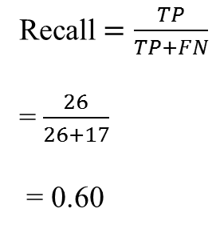
Recall, or True Positive Rate (TPR): what fraction of all positive instances does the classifier correctly identify as positive?
TN = 400 | FP = 7
FN = 17 | TP = 26
True negative
Recall $=\frac{TP}{TP+FN}$
= $\frac{26}{26+17}$
= 0.60
True
positive
N = 450
Recall is also known as:
True Positive Rate (TPR)
Sensitivity
Probability of detection
Predicted
negative
Predicted
positive
Notes:
Confusion_matrix_recall

Slide 72
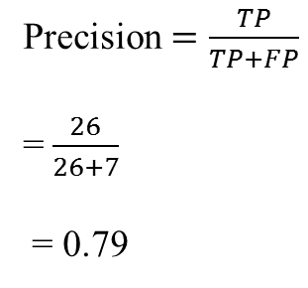
Precision: what fraction of positive predictions are correct?
TN = 400 | FP = 7
FN = 17 | TP = 26
Precision $=\frac{TP}{TP+FP}$
= $\frac{26}{26+7}$
= 0.79
True negative
True
positive
N = 450
Predicted
negative
Predicted
positive
Notes:
Confusion_matrix_precision

Slide 73
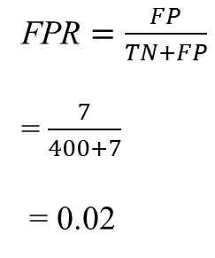
False positive rate (FPR): what fraction of all negative instances does the classifier incorrectly identify as positive?
TN = 400 | FP = 7
FN = 17 | TP = 26
True negative
FPR $=\frac{FP}{TN+FP}$
= $\frac{7}{400+7}$
= 0.02
True
positive
N = 450
Predicted
negative
Predicted
positive
False Positive Rate is also known as:
Specificity
Notes:
Confusion_matrix_FPR

Slide 74
A Graphical Illustration of Precision & Recall
TN = | FP =
FN = | TP =
Notes:
Graphical_PR-1

Slide 75
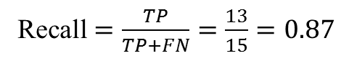
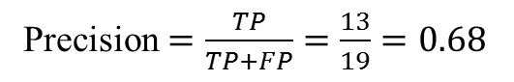
The Precision-Recall Tradeoff
TN = 429 | FP = 6
FN = 2 | TP = 13
True positive
Predict
Positive
Predict
Negative
False positive
True negative
False negative
Precision $=\frac{TP}{TP+FP}=\frac{13}{19}=0.68$
Recall $=\frac{TP}{TP+FN}=\frac{13}{15}=0.87$
Notes:
Graphical_PR_2

Slide 76
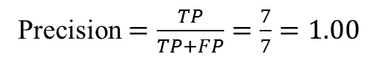
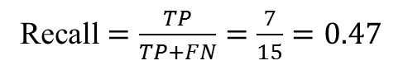
High Precision, Lower Recall
TN = 435 | FP = 0
FN = 8 | TP = 7
Precision $=\frac{TP}{TP+FP}=\frac{7}{7}=1.00$
Recall $=\frac{TP}{TP+FN}=\frac{7}{15}=0.47$
Notes:
High_precision_classifier

Slide 77
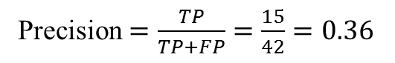
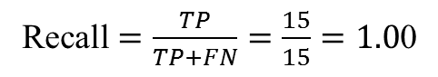
Low Precision, High Recall
TN = 408 | FP = 27
FN = 0 | TP = 15
Precision $=\frac{TP}{TP+FP}=\frac{15}{42}=0.36$
Recall $=\frac{TP}{TP+FN}=\frac{15}{15}=1.0$0
Notes:
High_recall_classifier

Slide 78
There is often a tradeoff between precision and recall
Recall-oriented machine learning tasks?
Precision-oriented machine learning tasks?
Notes:
PR_tradeoff

Slide 79
There is often a tradeoff between precision and recall
Recall-oriented machine learning tasks:
Search and information extraction in legal discovery
Tumor detection
Often paired with a human expert to filter out false positives
Precision-oriented machine learning tasks:
Search engine ranking, query suggestion
Document classification
Many customer-facing tasks (users remember failures!)
Notes:
PR_tradeoff

Slide 80
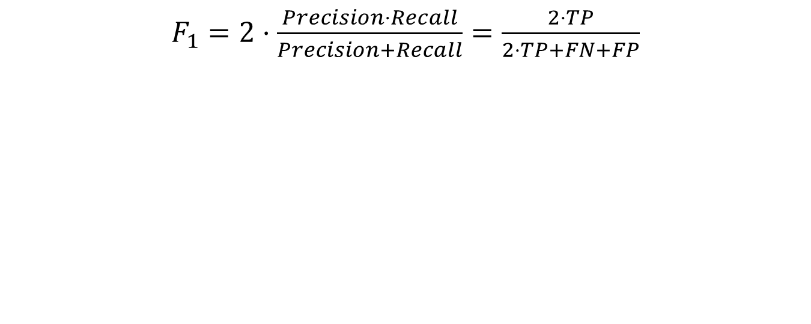
F1-score: combining precision & recall into a single number
$F_{1}=2⋅\frac{Precision⋅Recall}{Precision+Recall}=\frac{2⋅TP}{2⋅TP+FN+FP}$
Notes:
Evaluation_f1

Slide 81
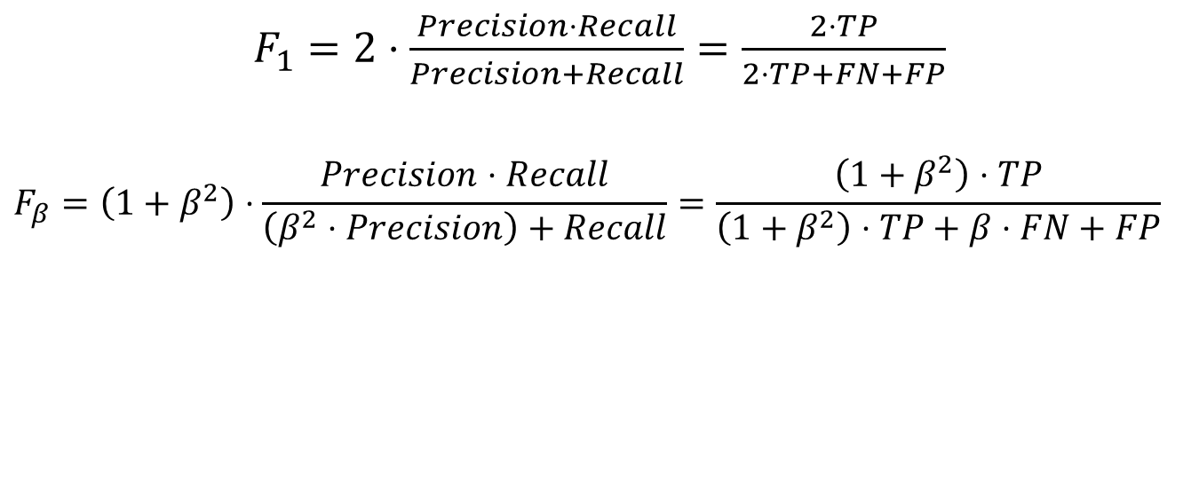
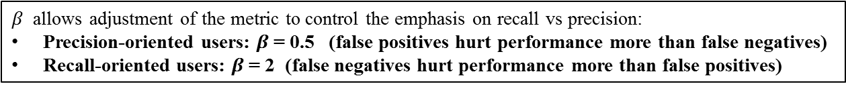
F-score: generalizes F1-score for combining precision & recall into a single number
$F_{1}=2⋅\frac{Precision⋅Recall}{Precision+Recall}=\frac{2⋅TP}{2⋅TP+FN+FP}$
$$F_{β}=\left(1+β^{2}\right)⋅\frac{Precision⋅Recall}{\left(β^{2}⋅Precision\right)+Recall}=\frac{\left(1+β^{2}\right)⋅TP}{\left(1+β^{2}\right)⋅TP+β⋅FN+FP}$$
$β$ allows adjustment of the metric to control the emphasis on recall vs precision:
Precision-oriented users: $β$= 0.5 (false positives hurt performance more than false negatives)
Recall-oriented users: $β$= 2 (false negatives hurt performance more than false positives)
Notes:
Evaluation_f_score

Slide 82
Think Pair Share
These results have:
A) The same precision and same recall.
B) The same precision but different recall.
C) Different precision but the same recall.
D) Different precision and recall.
 | Positive Label | Negative Label
Positive | 250 | 45
Negative | 35 | 60
 | Positive Label | Negative Label
Positive | 250 | 45
Negative | 35 | 660

Slide 83
Precision-Recall and ROC curves

Slide 84
Hard vs Soft Classification
0.98
0.50
0.50
1
0.75
0
0.35
0.50
0.05

Slide 85
Imagine sorting all test points by their classifier score
True Label | Classifier score
0 | -27.6457
0 | -25.8486
0 | -25.1011
0 | -24.1511
0 | -23.1765
0 | -22.575
0 | -21.8271
0 | -21.7226
0 | -19.7361
0 | -19.5768
0 | -19.3071
0 | -18.9077
0 | -13.5411
0 | -12.8594
1 | -3.9128
0 | -1.9798
1 | 1.824
0 | 4.74931
1 | 15.234624
1 | 21.20597
+21.20
+1.824
1
+4.74
0
-19.73
-27.64

Slide 86
Decision Functions (decision_function)
True Label | Classifier score
0 | -27.6457
0 | -25.8486
0 | -25.1011
0 | -24.1511
0 | -23.1765
0 | -22.575
0 | -21.8271
0 | -21.7226
0 | -19.7361
0 | -19.5768
0 | -19.3071
0 | -18.9077
0 | -13.5411
0 | -12.8594
1 | -3.9128
0 | -1.9798
1 | 1.824
0 | 4.74931
1 | 15.234624
1 | 21.20597
Each classifier score value per test point indicates how confidently the classifier predicts the positive class (large-magnitude positive values) or the negative class (large-magnitude negative values).
Choosing a fixed decision threshold gives a classification rule.
By sweeping the decision threshold through the entire range of possible score values, we get a series of classification outcomes that form a curve.
Notes:
Decision_functions

Slide 87
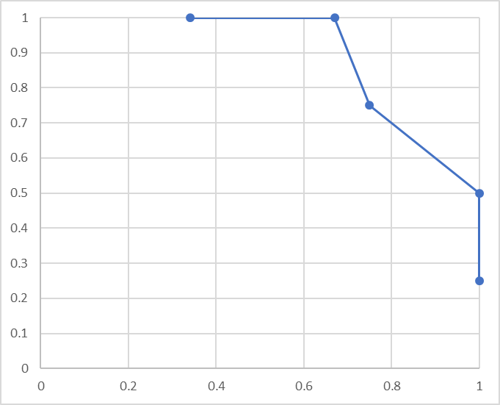
Varying the Decision Threshold
True Label | Classifier score
0 | -27.6457
0 | -25.8486
0 | -25.1011
0 | -24.1511
0 | -23.1765
0 | -22.575
0 | -21.8271
0 | -21.7226
0 | -19.7361
0 | -19.5768
0 | -19.3071
0 | -18.9077
0 | -13.5411
0 | -12.8594
1 | -3.9128
0 | -1.9798
1 | 1.824
0 | 4.74931
1 | 15.234624
1 | 21.20597
Classifier score threshold | Precision | Recall
-20 | 4/12=0.34 | 4/4=1.00
-10 | 4/6=0.67 | 4/4=1.00
0 | 3/4=0.75 | 3/4=0.75
10 | 2/2=1.0 | 2/4=0.50
20 | 1/1=1.0 | 1/4 = 0.25
Recall
Precision
Notes:
Varying_threshold

Slide 88
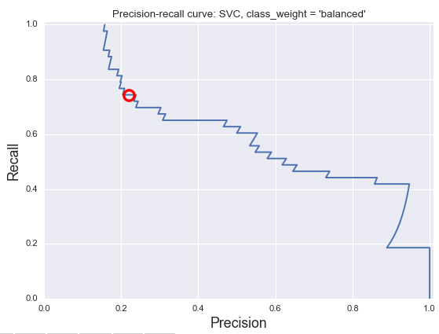
Precision-Recall Curves
X-axis: Precision
Y-axis: Recall
Top right corner:
The “ideal” point
Precision = 1.0
Recall = 1.0
Notes:
PR_intro_2

Slide 89
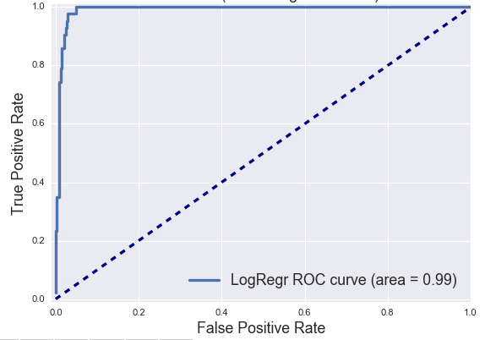
ROC Curves
X-axis: False Positive Rate
Y-axis: True Positive Rate
Top left corner:
The “ideal” point
False positive rate of zero
True positive rate of one
Notes:
ROC_intro1

Slide 90
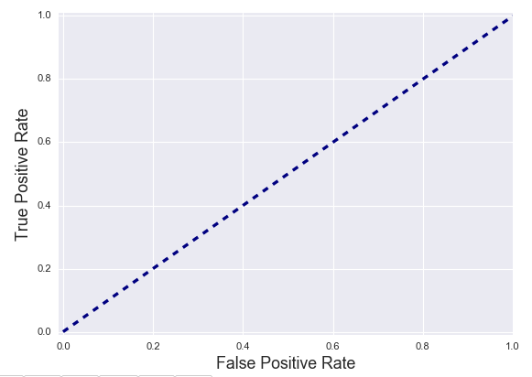
ROC curve examples: random guessing
Notes:
ROC_curve_examples_guessing

Slide 91
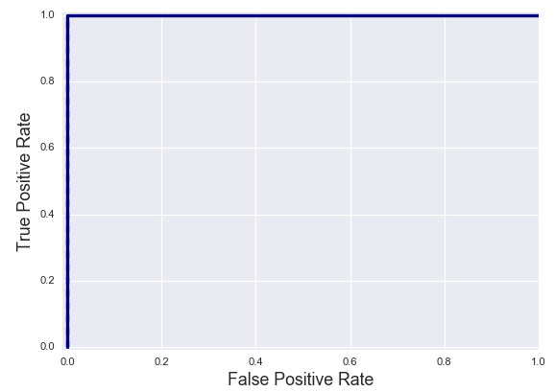
ROC curve examples: perfect classifier
Notes:
ROC_curve_examples_perfect

Slide 92
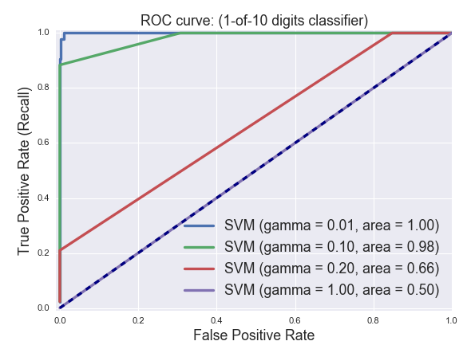
Summarizing an ROC curve in one number: Area Under the Curve (AUC)
AUC = 0 (worst) AUC = 1 (best)
AUC can be interpreted as:
1. The total area under the ROC curve.
2. The probability that the classifier will assign a higher score to a randomly chosen positive example than to a randomly chosen negative example.
Advantages:
Gives a single number for easy comparison.
Does not require specifying a decision threshold.
Drawbacks:
As with other single-number metrics, AUC loses information, e.g. about tradeoffs and the shape of the ROC curve.
This may be a factor to consider when e.g. wanting to compare the performance of classifiers with overlapping ROC curves.
Notes:
AUC_summary

Slide 93
What evaluation measures are available?
from sklearn.metrics.scorer import SCORERS
print(sorted(list(SCORERS.keys())))
from sklearn.metrics.scorer import SCORERS
​
print(sorted(list(SCORERS.keys())))
['accuracy', 'adjusted_mutual_info_score', 'adjusted_rand_score', 'average_precision', 'completeness_score', 'explained_variance', 'f1', 'f1_macro', 'f1_micro', 'f1_samples', 'f1_weighted', 'fowlkes_mallows_score', 'homogeneity_score', 'log_loss', 'mean_absolute_error', 'mean_squared_error', 'median_absolute_error', 'mutual_info_score', 'neg_log_loss', 'neg_mean_absolute_error', 'neg_mean_squared_error', 'neg_mean_squared_log_error', 'neg_median_absolute_error', 'normalized_mutual_info_score', 'precision', 'precision_macro', 'precision_micro', 'precision_samples', 'precision_weighted', 'r2', 'recall', 'recall_macro', 'recall_micro', 'recall_samples', 'recall_weighted', 'roc_auc', 'v_measure_score']

Slide 94
Concluding Notes
Accuracy is often not the right evaluation metric for many real-world machine learning tasks
False positives and false negatives may need to be treated very differently
Make sure you understand the needs of your application and choose an evaluation metric that matches your application, user, or business goals.
Examples of additional evaluation methods include:
Learning curve: How much does accuracy (or other metric) change as a function of the amount of training data?
Sensitivity analysis: How much does accuracy (or other metric) change as a function of key learning parameter values?
Notes:
Conclusion

Slide 95
Optimizing Classifiers for Different Evaluation Metrics

Slide 96
Certain functions (parameter search) can take an evaluation metric as a parameter
clf = Logistic(C=100.0).fit(X_twovar_train, y_train)
grid_values = {'class_weight':['balanced', {1:2},{1:3},{1:4},{1:5},{1:10},{1:20},{1:50}]}
plt.figure(figsize=(10,7))
for i, eval_metric in enumerate(('precision','recall', 'f1','roc_auc')):
grid_clf_custom = GridSearchCV(clf, param_grid=grid_values, scoring=eval_metric)
grid_clf_custom.fit(X_twovar_train, y_train)
... etc

Slide 97
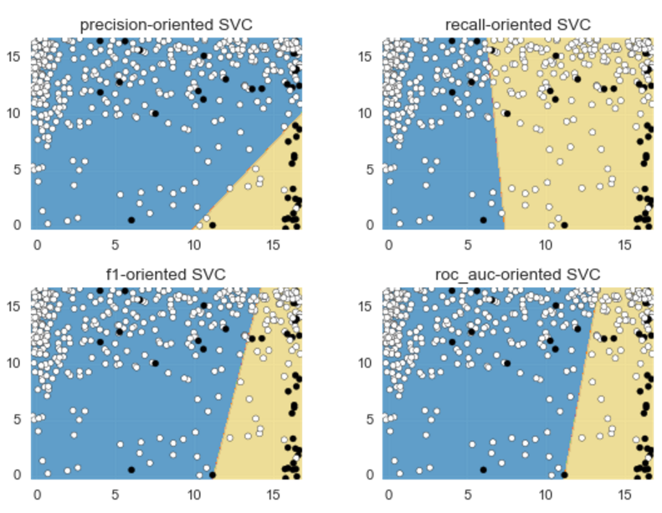
Example: Optimizing a Classifier Using Different Evaluation Metrics
Notes:
Example_svc_optimized

Slide 98
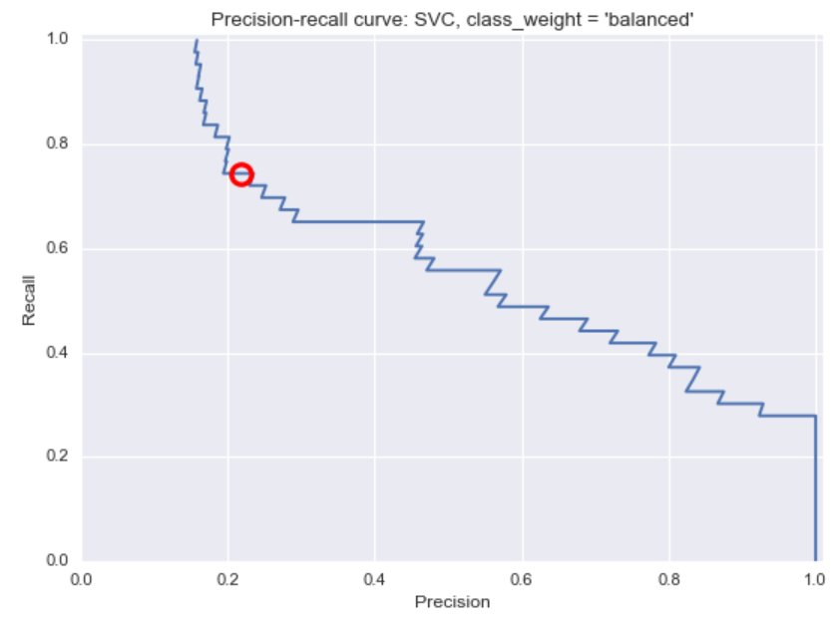
Example: Precision-Recall Curve of Default Support Vector Classifier
Notes:
Example_PR_Curve

Slide 99
Training, Validation, and Test Framework for Model Selection and Evaluation
Using only cross-validation or a test set to do model selection may lead to more subtle overfitting / optimistic generalization estimates
Why?
Instead, use three data splits:
1. Training set (model building)
2. Validation set (model selection—tune parameters, but never fit models)
3. Test set (final evaluation)
In practice:
Create an initial training/test split
Do cross-validation on the training data for model/parameter selection
Save the held-out test set for final model evaluation
Notes:
Train_validation_test

Slide 100
Multi-Class Evaluation (Next week)

Slide 101
Multi-Class Evaluation
Multi-class evaluation is an extension of the binary case.
A collection of true vs predicted binary outcomes, one per class
Confusion matrices are especially useful
Classification report
Overall evaluation metrics are averages across classes
But there are different ways to average multi-class results: we will cover these shortly.
The support (number of instances) for each class is important to consider, e.g. in case of imbalanced classes
Multi-label classification: each instance can have multiple labels (not covered here)
Notes:
Multi-class_summary

Slide 102

Multi-Class Confusion Matrix
True Digit
Predicted Digit
Notes:
Multi-class confusion

Slide 103
Micro vs Macro Average
Macro-average:
Each class has equal weight.
Compute metric within each class
Average resulting metrics across classes
Class | Predicted Class
orange | lemon
orange | lemon
orange | apple
orange | orange
orange | apple
lemon | lemon
lemon | apple
apple | apple
apple | apple
Correct?
0
0
0
1
0
1
0
1
1
Class Precision
orange 1/5 = 0.20
lemon 1/2 = 0.50
apple 2/2 = 1.00
Macro-average precision:
(0.20 + 0.50 + 1.00) / 3 = 0.57
Notes:
Micro-average1

Slide 104
Micro vs Macro Average
Micro-average:
Each instance has equal weight.
Largest classes have most influence
Aggregrate outcomes across all classes
Compute metric with aggregate outcomes
Class | Predicted Class
orange | lemon
orange | lemon
orange | apple
orange | orange
orange | apple
lemon | lemon
lemon | apple
apple | apple
apple | apple
Correct?
0
0
0
1
0
1
0
1
1
Micro-average precision: 4 / 9 = 0.44
Notes:
Macro-average

Slide 105
Macro-Average vs Micro-Average
If the classes have about the same number of instances, macro- and micro-average will be about the same.
If some classes are much larger (more instances) than others, and you want to:
Weight your metric toward the largest ones, use micro-averaging.
Weight your metric toward the smallest ones, use macro-averaging.
If the micro-average is much lower than the macro-average then examine the larger classes for poor metric performance.
If the macro-average is much lower than the micro-average then examine the smaller classes for poor metric performance.
Notes:
Macro_vs_micro average

Slide 106
Multi-class Evaluation Metrics via the "Average" Parameter for a Scoring Function
Micro: Metric on aggregated instances
Macro: Mean per-class metric, classes have equal weight
Weighted: Mean per-class metric, weighted by support
Samples: for multi-label problems only
Notes:
Average_parameter

